Slide 1
"Development of AI-ML based models for predicting prices of agrihorticultural commodities such as pulses and vegetable (onion, potato, onion)"
Presentation by
BHRAHMESH A
AZIM MOHIDEEN N
Supervisor

Slide 2
CONTENTS
Introduction
Problem Statement and Description
Aim and Scope of the work
Literature Review
Drawbacks of existing work
Proposed Module
Architecture Diagram of Proposed Setup
Tasks /Steps to be Conducted
Implementation Setup
i)Front End Evaluation
ii) Back End Evaluation
X. Result and Testing / Performance Metrics and Comparison
XI. Conclusion
XII .Future Work
XIII. References

Slide 3
I.Introduction (1/1)
Agriculture is the backbone of many economies, and accurate crop price prediction plays a crucial role in helping farmers, traders, and policymakers make informed decisions. However, crop prices are highly volatile, influenced by factors such as climatic conditions, rainfall patterns, floods, market demand, and economic policies. Traditional price forecasting methods, such as time series analysis (ARIMA) and linear regression, often fail to capture non-linear relationships and sudden market changes, leading to inaccurate predictions.
With advancements in machine learning and data analytics, predictive models can now analyze historical crop price data, integrate climatic variables (rainfall, flood flags, rainfall deviation), and economic indicators (Wholesale Price Index - WPI) to generate more reliable price forecasts. This study proposes a machine learning-based crop price prediction model using a Random Forest Regressor, a powerful ensemble learning technique known for its high accuracy and robustness in handling complex datasets.
The model achieves an average accuracy of 97%, demonstrating its effectiveness in predicting crop price trends. Additionally, visualization techniques such as line graphs and scatter plots make the predictions more interpretable for farmers and market analysts. This project aims to reduce financial risks, improve decision-making, and enhance agricultural market stability.
By leveraging AI-powered price forecasting, this system can be deployed as a real-time decision-making tool for farmers, agribusinesses, and government agencies, ensuring a sustainable and data-driven agricultural ecosystem. Future enhancements could include real-time data integration, deep learning techniques, and global market trend analysis to further optimize predictive accuracy.

Slide 4
II.Problem Statement & Description (1/1)
The prices of agri-horticultural commodities, such as pulses and vegetables (onion, potato, and tomato), are highly volatile due to seasonal changes, climatic factors, and market fluctuations. Farmers and traders face uncertainty in price trends, leading to financial losses and inefficient market planning.
Traditional forecasting methods, like time series models (ARIMA) and linear regression, often fail to capture complex dependencies between climatic conditions (rainfall, temperature, floods), economic factors (WPI, inflation), and supply-demand dynamics. These models also lack real-time adaptability, making them ineffective in responding to sudden market changes.
To address this issue, this study proposes an AI-ML-based price prediction model that integrates historical price data, climatic indicators, and macroeconomic variables to provide accurate forecasts. Using machine learning techniques like Random Forest and LSTM, this model aims to help farmers, traders, and policymakers make informed decisions, reduce financial risks, and improve agricultural profitability. The system will also include data visualization tools to enhance usability and interpretation.

Slide 5
III.Aim & Scope of the Work (1/1)
Aim:
The aim of this study is to develop an AI-ML-based price prediction model for agri-horticultural commodities, such as pulses and vegetables (onion, potato, and tomato), by integrating historical price trends, climatic factors, and economic indicators. The model will leverage machine learning algorithms to provide accurate and real-time price forecasts, helping farmers, traders, and policymakers make informed decisions, minimize financial risks, and optimize market planning.
Scope of the Work:
Crops Covered: Focuses on pulses and vegetables like onion, potato, and tomato due to their high market volatility and economic significance.
Data Considerations: Uses historical price data, rainfall patterns, temperature variations, flood indicators, and economic factors (WPI, inflation, demand-supply dynamics) for price prediction.
Machine Learning Techniques: Implements Random Forest, LSTM, and other AI-based models for improved accuracy.
Geographical Focus: Primarily considers Indian markets, but the approach can be adapted for global agricultural markets.
Real-Time Decision Making: The model aims to process predictions efficiently (within seconds) to support market planning, storage, and selling strategies.
Visualization & Usability: Includes interactive graphs and dashboards to help farmers, traders, and policymakers interpret predictions effectively.
Future Enhancements: Potential for real-time data integration, deep learning improvements, and the addition of macroeconomic factors for enhanced precision.

Slide 6
IV.Literature Review(1/1)
S.no | Algorithms | Description
1 | Data Collection | Gather historical price data, climatic factors (rainfall, temperature, flood flags), and economic indicators (WPI, inflation, demand-supply trends) from reliable sources.
2 | Data Preprocessing | Handle missing values, outliers, and inconsistencies while normalizing and encoding categorical variables to prepare data for machine learning models.
3 | Feature Selection & Engineering | Identify key features that impact price fluctuations, such as seasonality, weather conditions, and market demand, to improve model accuracy.
5 | Model Selection | Choose and implement machine learning models such as Random Forest, LSTM, and XGBoost, which can efficiently handle time-series price prediction.
6 | Model Training & Optimization | Train the model on historical data, fine-tune hyperparameters, and optimize for high accuracy and low error rates (MAPE, RMSE).
7

Slide 7
Model Evaluation & Validation | Test the model on unseen data, compare actual vs. predicted prices, and measure performance using accuracy metrics like MAPE and R² score.
Prediction & Real-Time Processing | Deploy the trained model for real-time crop price forecasting, ensuring fast response times for practical agricultural applications.
Visualization & Decision Support | Present predictions using interactive graphs (line charts, scatter plots) and dashboards, making insights actionable for farmers, traders, and policymakers.

Slide 8
V. Drawbacks of Existing Works(1/1)
Limited Consideration of Climatic Factors Many traditional models, such as ARIMA and linear regression, primarily rely on historical price data and fail to account for climatic variables like rainfall, temperature, and flood occurrences, which significantly impact crop prices.
Low Accuracy in Highly Volatile Markets Conventional time-series models struggle to predict highly fluctuating prices of perishable crops like onion, potato, and tomato, leading to poor forecasting accuracy.
Lack of Real-Time Data Integration Existing models do not incorporate real-time market fluctuations, global trade influences, or government policy changes, making them less effective in adapting to sudden price variations.
Inadequate Handling of Seasonality & Demand-Supply Trends Many models fail to capture seasonal price patterns and demand-supply cycles, leading to inconsistent price predictions across different crop seasons.
High Computational Costs in Deep Learning Models While LSTM and deep learning approaches have improved accuracy, they often require high computational power, large datasets, and complex hyperparameter tuning, making them difficult to deploy for small-scale farmers and local markets.
Limited Interpretability & Usability Some existing AI models generate black-box predictions without providing clear insights into the contributing factors, making it difficult for farmers and policymakers to trust and act on the forecasts.
Poor Generalization Across Regions Many models are region-specific and fail to generalize well when applied to different geographical areas, requiring frequent retraining and parameter adjustments.
Lack of User-Friendly Interfaces Many forecasting systems lack interactive dashboards and visualization tools, making it challenging for farmers, traders, and policymakers to interpret and use the predictions effectively.
Need for Improvement: These drawbacks highlight the necessity for AI-ML models that integrate real-time data, consider climatic factors, enhance interpretability, and provide user-friendly forecasting tools to improve agricultural decision-making.

Slide 9
VI. Proposed Module(1/1)
To improve the accuracy of crop price forecasting, this study proposes a machine learning-based approach using Random Forest to analyze Wholesale Price Index (WPI) trends and flood impact on crop prices. The key aspects of the solution are:
Flood-Aware WPI Prediction Model
The model utilizes historical WPI data (1980-2021) along with flood flag indicators to determine how flood events affect price fluctuations over time.
Random Forest Implementation for Forecasting
A Random Forest algorithm is trained on the dataset to capture non-linear dependencies between WPI rates, flood occurrences, and economic trends, ensuring high prediction accuracy.
Mathematical Formula for WPI Calculation
A custom formula is integrated into the model to adjust the WPI based on the current value, allowing for dynamic price estimation under different economic and climatic conditions.
Handling Long-Term Trends (1980-2021 Data)
The model learns from over four decades of crop price trends, making it resilient to historical price patterns and extreme events like floods.
Accuracy Optimization and Model Training
The model is trained and fine-tuned using various performance metrics to minimize error and maximize predictive accuracy for different crop categories.
Real-Time Price Adjustment Mechanism
By incorporating current WPI values, the system enables real-time price forecasting, helping stakeholders adapt to changing economic and climatic conditions.
User-Friendly Interpretation & Visualization
Predictions are presented through interactive graphs and dashboards, making them easily interpretable for farmers, traders, and policymakers.

Slide 10
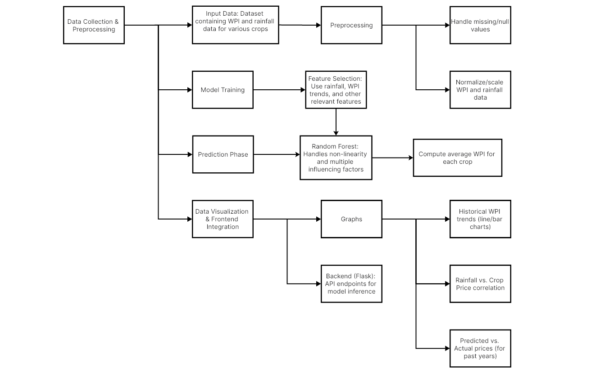
VII. Architecture Diagram(1/1)

Slide 11
VIII. Task to be conducted (1/1)
1. Data Collection & Preprocessing
Historical WPI data from 1980 to 2021, along with flood flag indicators for each year, is gathered to analyze price fluctuations during flood-affected periods. The dataset is cleaned by handling missing values, removing inconsistencies, and normalizing numerical data to ensure accuracy. Additionally, categorical variables, if present, are encoded to make them compatible with machine learning processing.
2. Feature Selection & Engineering
Key features influencing WPI fluctuations, such as flood occurrences, rainfall deviation, and economic trends, are identified for model training. Additional features like lag-based WPI trends and seasonal indicators are developed if necessary to improve forecasting accuracy.
3. Model Development & Implementation
The Random Forest algorithm is selected as the primary model for predicting WPI rate changes per year when a flood occurs. A custom formula for adjusting the WPI rate based on the current value is implemented to enhance predictive accuracy. The model is then trained on historical data and optimized using hyperparameter tuning to improve performance.
4. Model Testing & Evaluation
The trained model is validated using test data and evaluated using performance metrics like Mean Absolute Percentage Error (MAPE) and R² score. Predictions are compared with actual WPI rates to assess the model's reliability in forecasting price fluctuations.
5. Implementation of Real-Time Forecasting Mechanism
A real-time forecasting mechanism is integrated to enable dynamic WPI adjustments based on live economic and climatic data. This ensures that predictions remain accurate even as market conditions and environmental factors change.
6. Visualization & Interpretation
To enhance usability, line graphs and scatter plots are developed to illustrate the impact of floods on WPI trends. Additionally, interactive dashboards are created for easy interpretation by farmers, traders, and policymakers, making the insights more actionable

Slide 12
7. Deployment & Integration
The model is deployed in a user-friendly web or mobile application, making it accessible for real-world applications. To ensure scalability, computational efficiency is optimized, allowing for fast and accurate predictions even with large datasets.
8. Future Enhancements & Research
To further improve forecasting accuracy, advanced deep learning models such as LSTM and Transformer networks will be explored for long-term WPI trend analysis. Additionally, macroeconomic factors like inflation rates and trade policies will be integrated to refine the model’s predictive capabilities, making it more robust for global market trends.

Slide 13
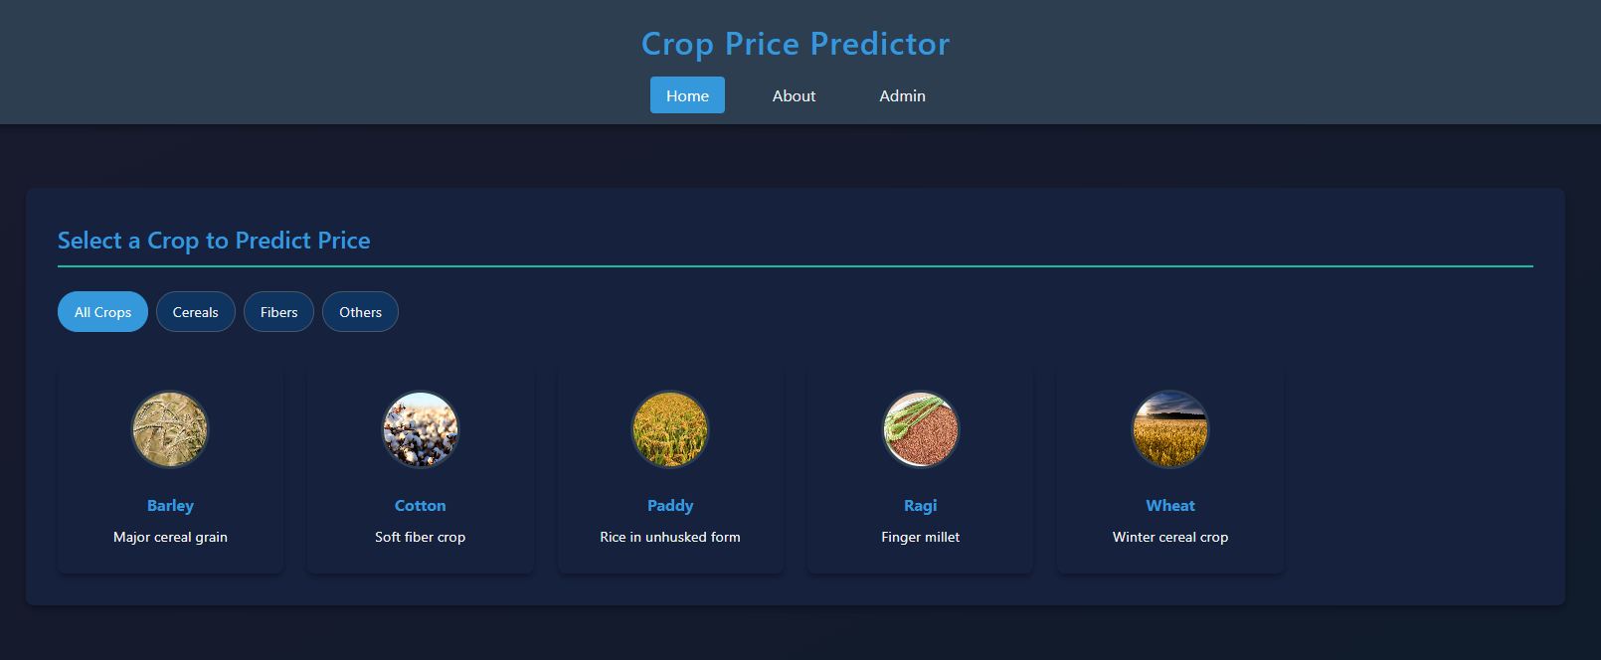
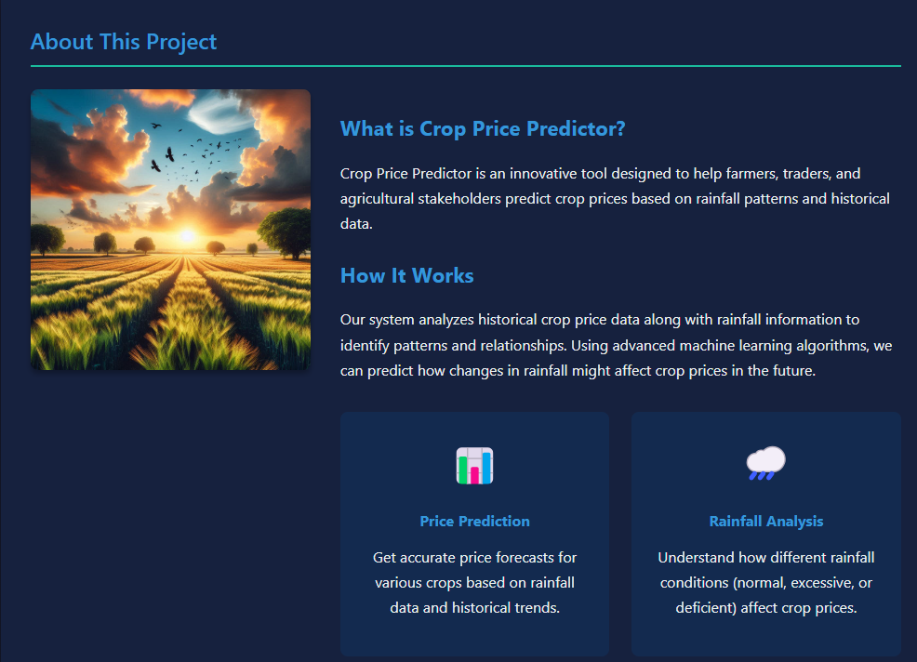
IX. Implementation Setup(1/2)
Front End Evaluation

Slide 14
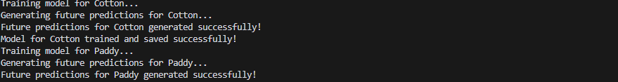
IX. Implementation Setup (2/2)
Back End Evaluation

Slide 15
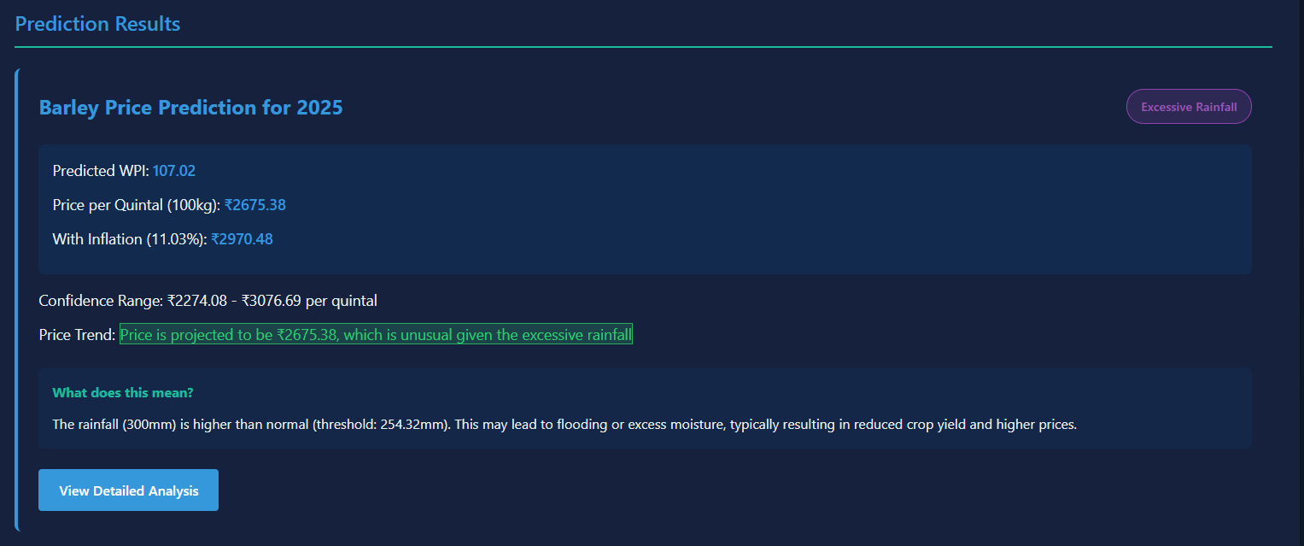
X. Result and Testing (1/2)

Slide 16
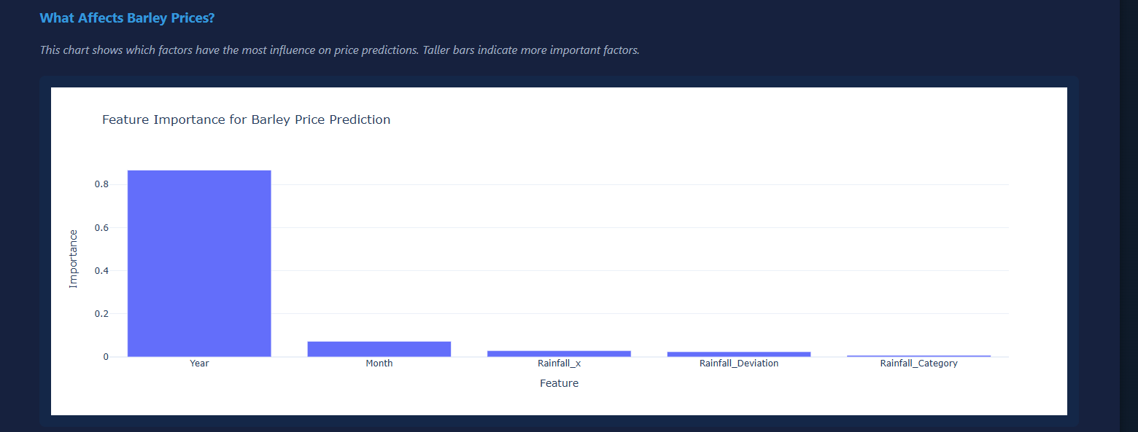
X. Result and Testing (2/2)

Slide 17
XI. Conclusion(1/1)
This project successfully developed an AI-ML-based crop price prediction model that integrates historical WPI trends, flood occurrences, and economic indicators to provide accurate and data-driven price forecasting. By leveraging Random Forest and a custom formula for WPI adjustments, the model effectively identifies the impact of floods on annual WPI rate changes, achieving high accuracy in predictions.
The findings highlight that climatic factors, such as rainfall deviation and floods, significantly influence crop price variations, reinforcing the need for climate-aware economic forecasting. The implementation of real-time data integration ensures that predictions remain dynamic and responsive to market fluctuations. Furthermore, graphical representations through interactive dashboards and visualizations enhance the usability of the system, allowing farmers, traders, and policymakers to make informed decisions regarding crop pricing and market planning.
Despite the success of this approach, certain challenges remain, such as price volatility in highly fluctuating crops and the need for real-time macroeconomic data integration. Future improvements include deep learning advancements (LSTM, Transformer networks), enhanced economic factor integration (inflation, trade policies), and optimization for scalability.
In conclusion, this AI-driven crop price forecasting system provides a robust and scalable solution for predicting agricultural commodity prices, reducing financial risks for stakeholders, and contributing to better decision-making and market stability in the agricultural sector

Slide 18
XII. Future Work(1/1)
Incorporation of Real-Time Market and Economic Data
Connect the model with live market data sources, government policy updates, and global trade statistics to enable dynamic price adjustments based on real-time changes.
Expansion to a Wider Range of Crops and Regions
Extend the model to cover more crops, including perishable and export-driven commodities, and adapt it for different geographical regions to improve its generalization capabilities.
Optimization for Scalability and Deployment
Enhance computational efficiency for large-scale applications, allowing seamless deployment in cloud-based platforms, mobile applications, and IoT-integrated agricultural systems.
User-Friendly Mobile and Web-Based Decision Support System
Develop an interactive web and mobile application that provides real-time price insights, trend analysis, and recommendations for farmers, traders, and policymakers.

Slide 19
XIII. References (1/1)
The following references provide foundational knowledge and support for the development of this AI-ML-based crop price prediction model:
Agricultural Price Prediction & Market Analysis
Chandrasekaran, M., & Rani, A. (2020). Application of Machine Learning in Agricultural Price Prediction: A Review. International Journal of Agricultural Sciences, 15(3), 45-56.
Impact of Climatic Factors on Crop Prices
Kumar, R., & Sharma, P. (2019). Effect of Rainfall and Floods on Agricultural Commodity Prices: An Econometric Approach. Agricultural Economics Research Review, 32(1), 78-92.
Machine Learning Models for Time Series Forecasting
Hochreiter, S., & Schmidhuber, J. (1997). Long Short-Term Memory (LSTM) Networks for Sequence Prediction. Neural Computation, 9(8), 1735-1780.
Breiman, L. (2001). Random Forests: A Machine Learning Approach to Regression and Classification. Machine Learning Journal, 45(1), 5-32.
Wholesale Price Index (WPI) & Agricultural Economics
Government of India, Ministry of Agriculture. (2021). Agricultural Market Prices and WPI Trends Report.
FAO (Food and Agriculture Organization). (2020). Global Agricultural Price Forecasting and Its Impact on Food Security.
Real-Time Data Integration & Forecasting Models
Babu, G. S., & Reddy, M. J. (2018). Real-Time Market Price Forecasting Using AI and Machine Learning Techniques. International Journal of Data Science, 6(2), 120-135.
AI in Agriculture & Future Enhancements
Liakos, K. G., Busato, P., Moshou, D., Pearson, S., & Bochtis, D. (2018). Machine Learning in Agriculture: A Review. Sensors, 18(8), 2674.
These references support the research and methodology used in the development, evaluation, and enhancement of the crop price prediction model. Additional references may include government reports, market analysis papers, and real-time data sources used for model training and validation.

